Slide 1

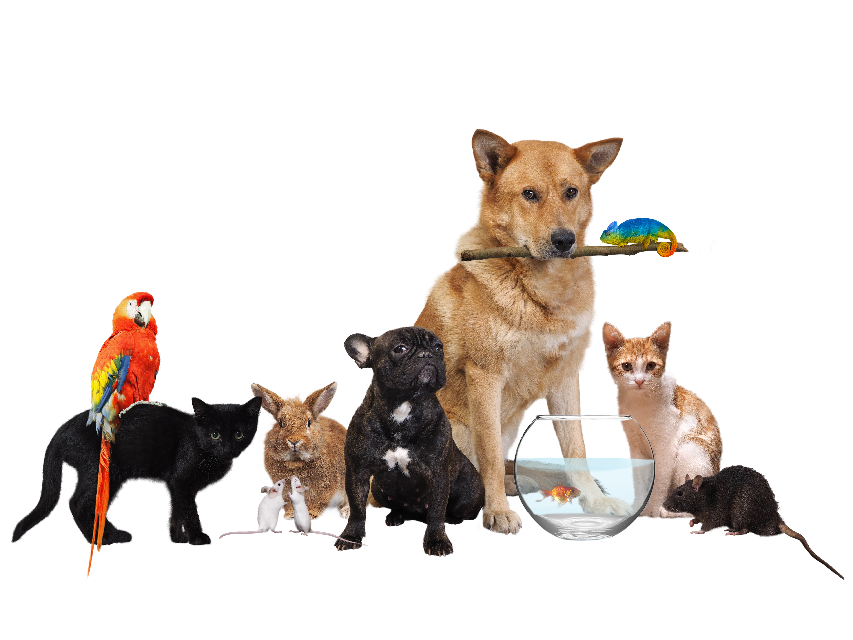
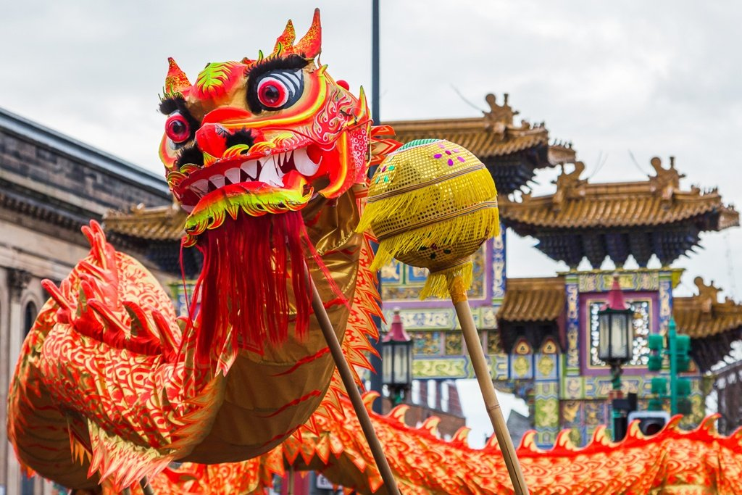
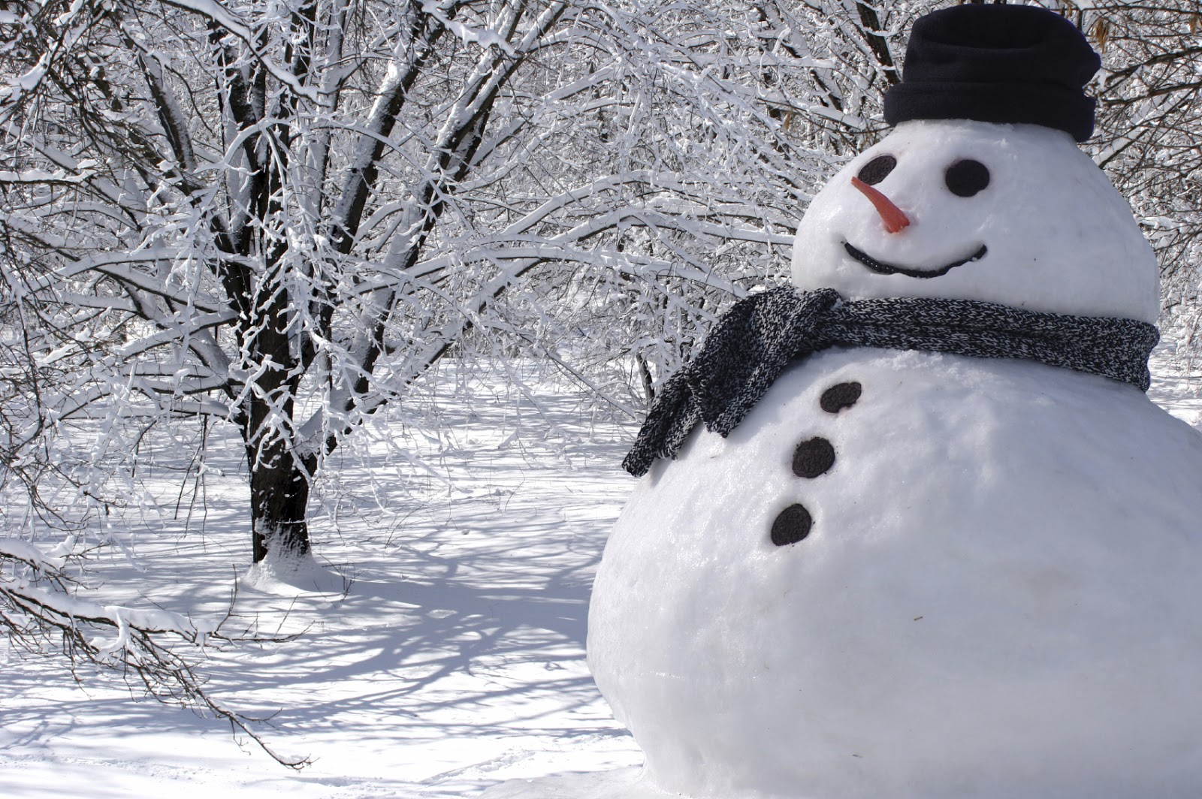
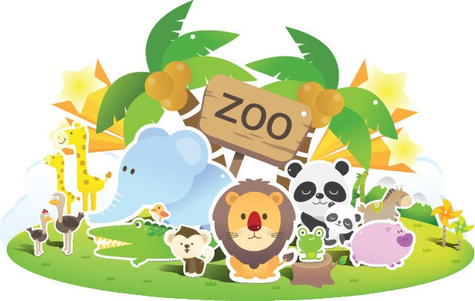
Year R – Knowledge Organiser – Animals/Chinese New Year
Vocabulary
animal | A living thing that breathes and moves.
vet | An animal doctor.
habitats | A place where something lives.
Chinese dragon/ Lion dance | A dance that takes place to bring good luck. Dragon or lion costumes are worn.
pet | A domesticated or calm animal kept for companionship or pleasure.
celebrate | Do something enjoyable to mark a special occasion.
pancake | A thin, round, flat piece of cooked batter.
Sticky Knowledge
Polar animals | Animals that have adapted to live in very cold places.
zoo | A place where wild animals are kept and displayed, so that people can go and look at them or study them.
Pets and pet shop | Pets are animals that people keep in their homes. A pet shop is a shop that sells things a pet needs to stay healthy.
Chinese New Year | Chinese New Year is the celebration of the new year on the Chinese calendar. In China is it often named the Spring Festival
Pancake day/Shrove Tuesday | Shrove Tuesday, or Pancake Day as it is sometimes known, is a traditional feast day before the start of Lent on Ash Wednesday
Winter | The season between Autumn and Spring when the weather is usually cold.

